Slide 1
Accent recognition
Spencer Riggins : sriggins2@gmu.edu
Siddi Avinash Chenmilla: schenmil@gmu.edu

Slide 2
Problem Definition
The purpose of this project is to explore and examine different features , and algorithmic techniques for the purpose of voice accent classification.
MFCC’s are an efficient way of representing the audio data. It is the go-to method when audio classification is involved. MFC is a representation of short-term power spectrum of a sound. It is based on a linear cosine transform of a log power spectrum on a nonlinear mel scale. MFCC corresponds to the coefficients of MFC.
The other feature we are using to represent the audio data is Chroma. Chroma based features are a powerful tool for analyzing pitches.
We are trying to see if we can build a good accent classifier with small amount of labeled data. For this we are using co-training algorithm.
We will determine if performing the co-training algorithm with a small amount of data can approach the accuracy rate given by training the classifiers on a large amount of labeled data.
Notes:
[Siddi]
The purpose of this project is to explore and examine different feature extraction, and algorithmic techniques for the purpose of voice accent classification. MFCC’s are an efficient way of representing the audio data. It is the go-to method when audio classification is involved. MFC is a representation of short-term power spectrum of a sound. It is based on a linear cosine transform of a log power spectrum on a nonlinear mel scale. MFCC corresponds to the coefficients of MFC. The other feature we are using to represent the audio data is Chroma. Chroma based features are a powerful tool for analyzing pitches. We are trying to see if we can build a good accent classifier with small amount of labeled data. For this we are using co-training algorithm. We will determine if performing the co-training algorithm with a small amount of data can approach the accuracy rate given by training the classifiers on a large amount of labeled data.

Slide 3

Experimental design
Extract MFCC and Chroma Features from MP3 Voice Files
150 Mp3 Files Per Class pulled from GMU Speech Accent Archive
India -> 7,521 Samples
North America -> 6,356 Samples
China -> 9,630 Samples
Perform k-folds cross validation on both MFCC and Chroma features to find optimal classifiers
Perform Co-Training Algorithm using classifiers found from cross validation
Wish to determine if co-training using MFCC and Chroma features improves classification accuracy
Notes:
[Spencer]
Not 100% percent sure this is what this slide will say, but something like this

Slide 4
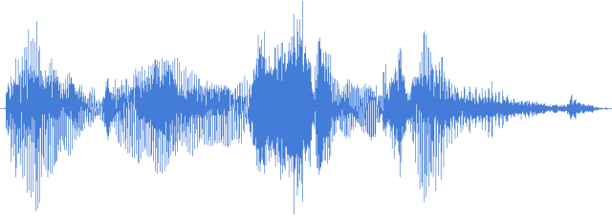

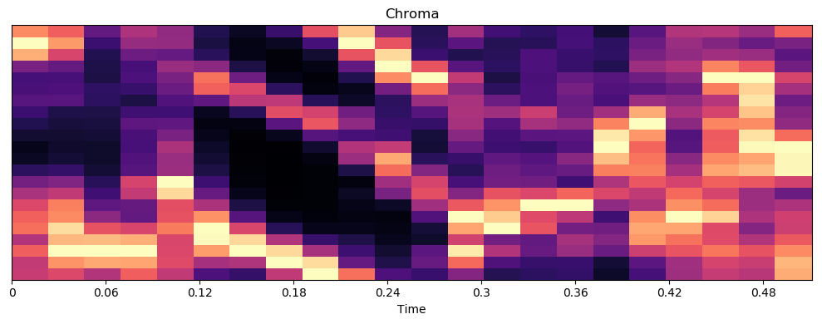
Feature Extraction Process
Please
Call
Stella
...
Waveform Data
Please
Call
Stella
...
Remove Silence
. . .
Re-Combine then Split
.5s
.5s
.5s
. . .
.5s
Extract Features From Chunks
Notes:
[Siddi]

Slide 5
MFCC and Chroma Features
chroma
Notes:
[Siddi]
Just showing a visual representation of MFCC and Chroma
Need To Fix Chroma Picture

Slide 6
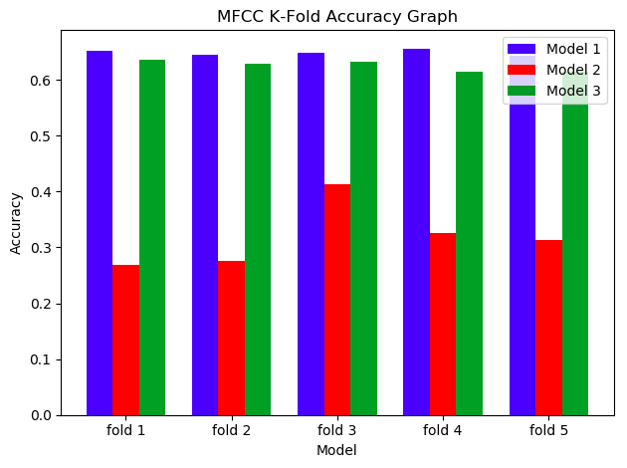
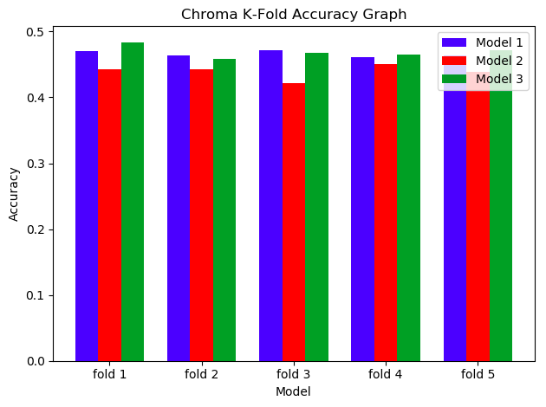
K-Folds Results
CNN With Dropout Regularization
CNN Without Regularization
CNN With Increased Kernel Size
Notes:
[Siddi]
We ran k-fold cross validation (k=5), for both MFCC and Chroma on three different models, 1) Convolutional model with Dropout, 2) Convolutional Model without dropout, 3) Convolutional model with dropout and increased kernel size.
We chose model (1) for MFCC data, and model (3) for Chroma data.

Slide 7

Co-Training Algorithm
Labeled
Data
Train
On
Classifier 1
Classifier 2
Add Most 1000 Most Confident Samples From Each Classifier To Labeled Data
Iterate Until All Samples Labeled
Predict
On
Unlabeled
Data
Notes:
[Spencer]

Slide 8
Co-Training Implementation
Use two most successful classifiers from k-folds
Train initially on 1,000 samples of labeled data
Each iteration, each classifier adds 20 samples to labeled training data
40 in total
Repeat for k = 100 iterations
Accuracy of each classifier is tested after each iteration on the pre-sampled test set
Notes:
[Spencer]

Slide 9
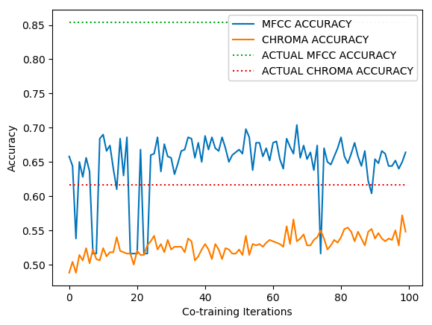
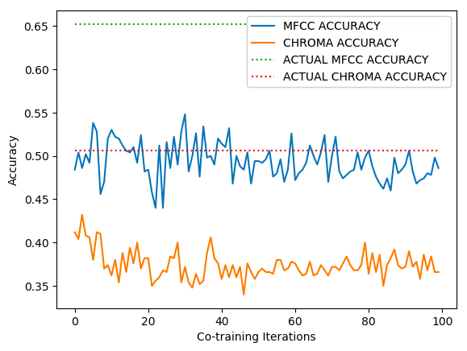
Notes:
[Spencer]
What’s with those dips in the MFCC accuracy??
Green Line - 20,000
Red Line -

Slide 10
Notes:
[Spencer]
What’s with those dips in the MFCC accuracy??

Slide 11
Conclusion / Future questions
Clear that both MFCC and Chroma are usable features for training accent classification systems
Unclear if co-training improves accuracy when starting with small amounts of labeled data
Dips in MFCC accuracy unexplained, but Chroma accuracy seems to trend upward
Are there optimal tunings of Co-Training Algorithm parameters?
Are there better features to use than Chroma and MFCC?
Notes:
[Spencer]

